Slide 1


P915
GROUP-6
A PRESENTATION ON
GROUP MEMBERS:
Ahmed Mohamed Alhassan Abashar
Mohita Dashora
Akshay Deo
Darshini M
Md Samreen
Sejal Sahu

Slide 2

Contents
Introduction
Excel
PowerBi
Tableau
MY SQL
Key Learnings
KPIs
Recommendation
Challenges
Conclusion

Slide 3
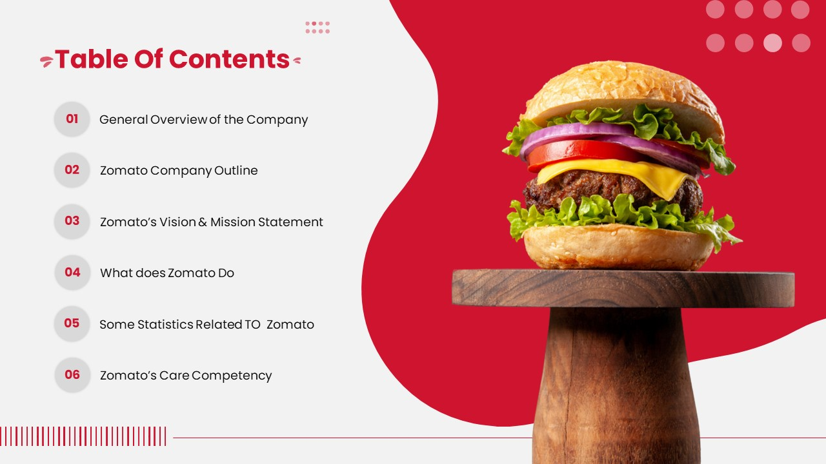
Introduction
Purpose: To analyze Zomato's restaurant dataset to uncover insights for improving business strategies and customer experience.
Focus: Understand restaurant distribution, ratings, costs, and operational trends, primarily in New Delhi and other regions.
Data Source: Zomato dataset with 9551 restaurants, covering attributes like location, cuisines, ratings, and opening dates (2010–2018).
Dataset Details: Includes 9551 restaurants, with fields like RestaurantID, City, Cuisines, Average_Cost_for_two (USD 96,412.32 total), Rating (avg 2.89), and features like table booking (12.12%) and online delivery (8.63%).
Outcome: Recommendations to improve data quality, promote delivery/booking, target high-rated strategies, optimize opening times, and expand regionally.

Slide 4
Total Restaurants : 9,551
Average Rating : 2.89 (most rated 2.9).
Total Country : 15
Top City: New Delhi (highest number of restaurants).
Popular Cuisine: North Indian .
Online Delivery : Only 25% offer it .
Top Opening Quarter : Q3 (july-sept) .
KPIs

Slide 5

EXCEL
DASHBOARD

Slide 6
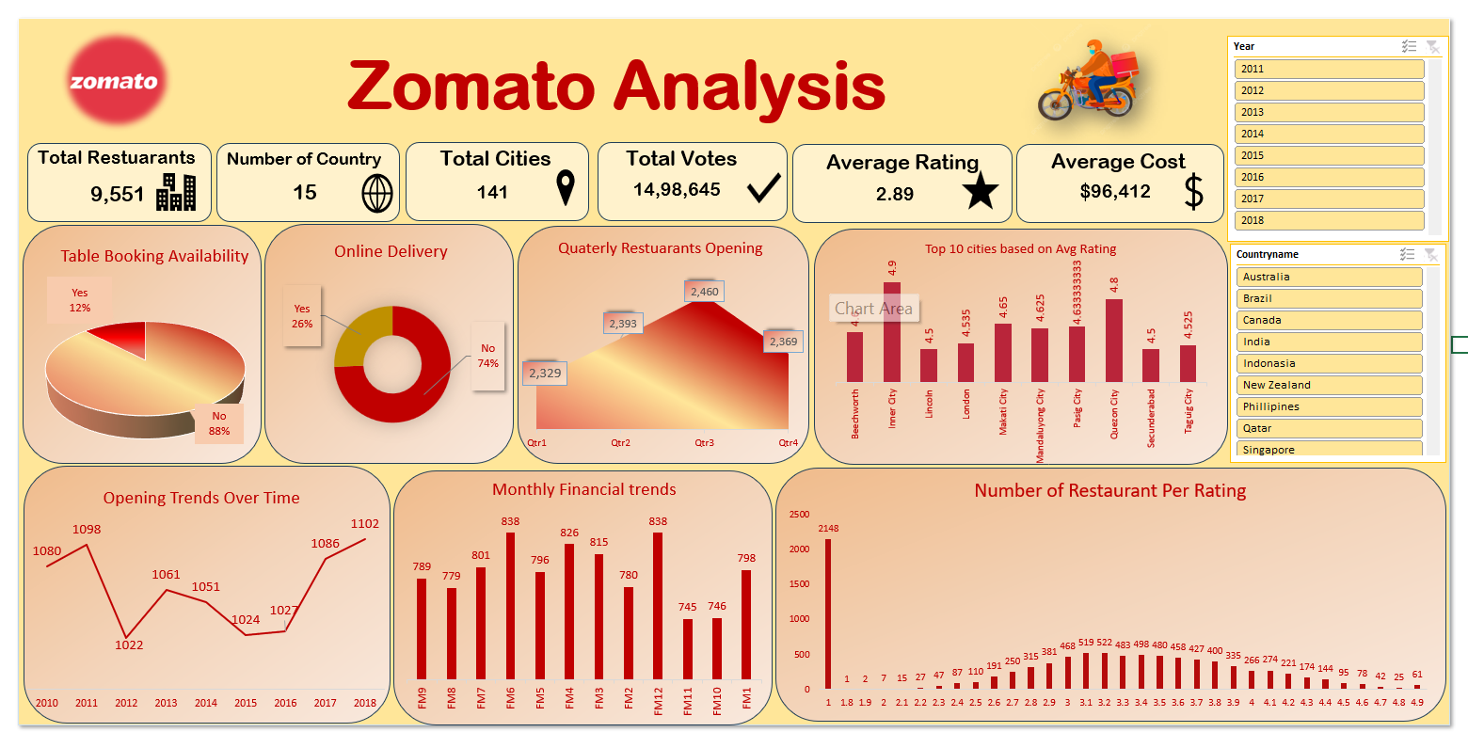

Slide 7

POWERBI
DASHBOARD

Slide 8
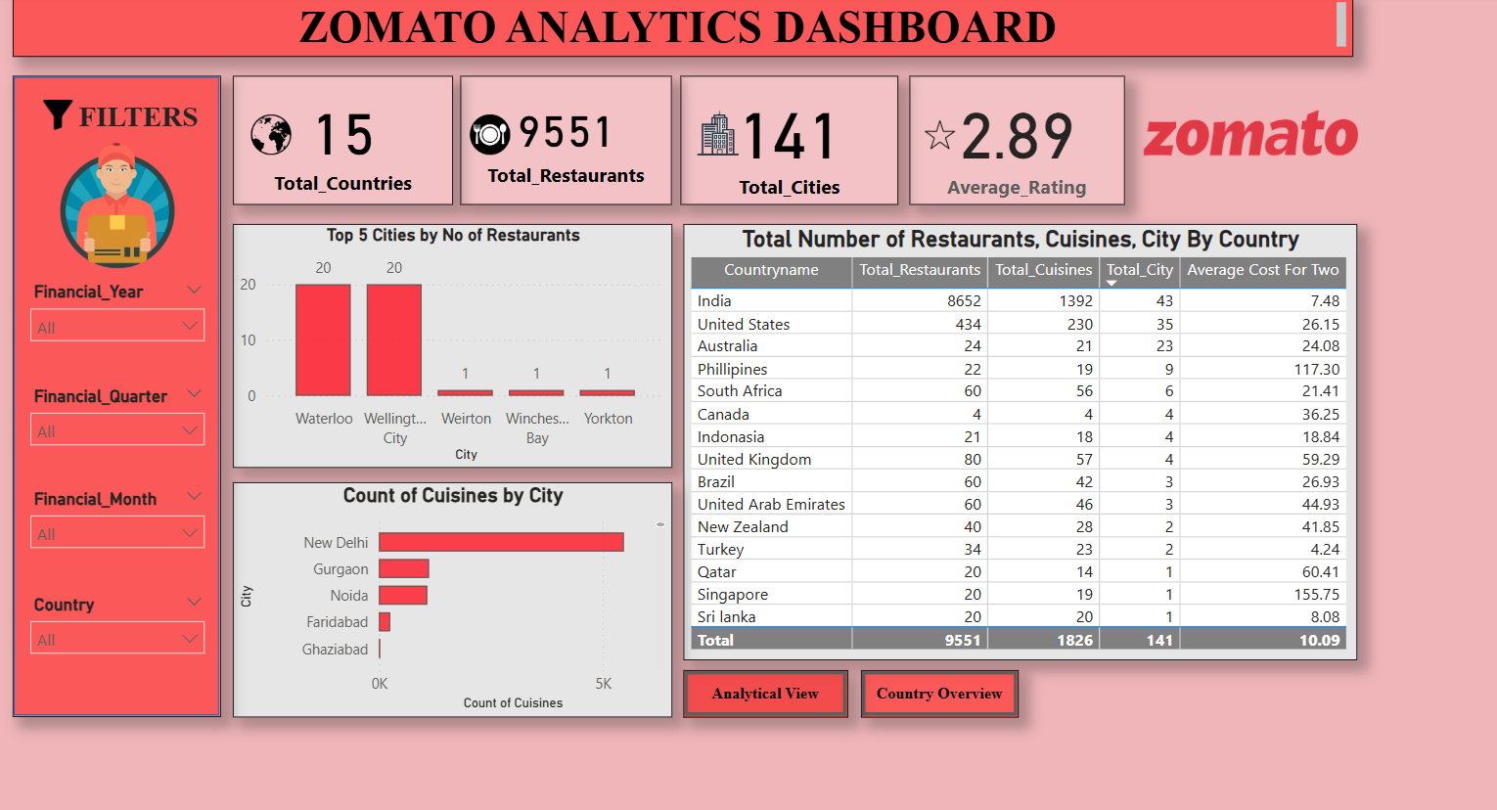

Slide 9
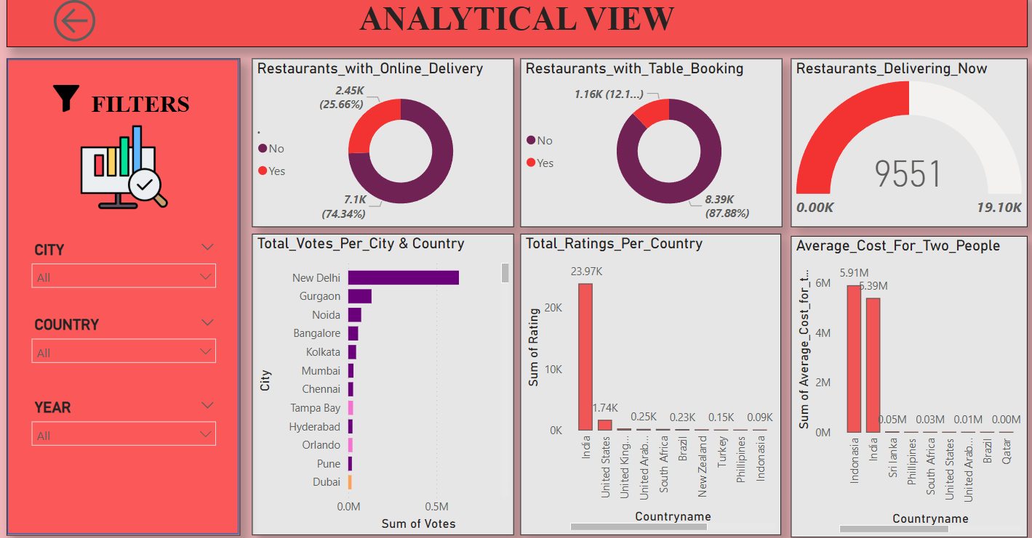

Slide 10

TABLEAU
DASHBOARD

Slide 11
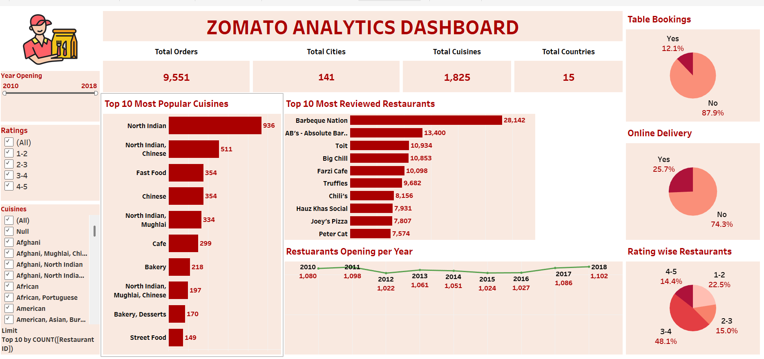

Slide 12

MY SQL QUERIES
DASHBOARD

Slide 13
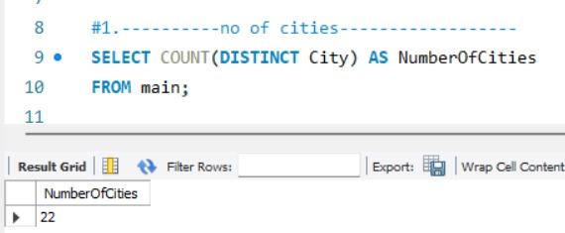
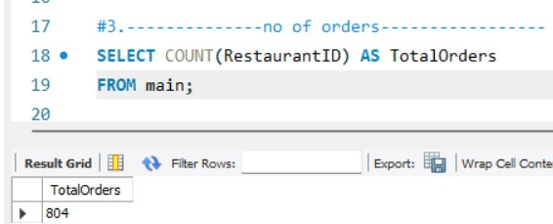
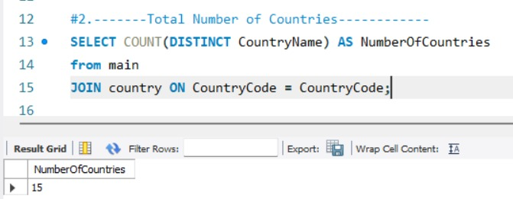
QUERIES

Slide 14
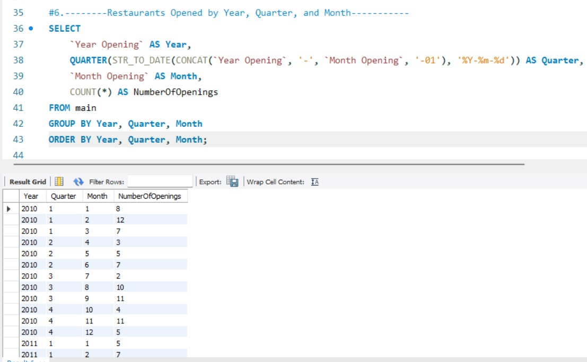
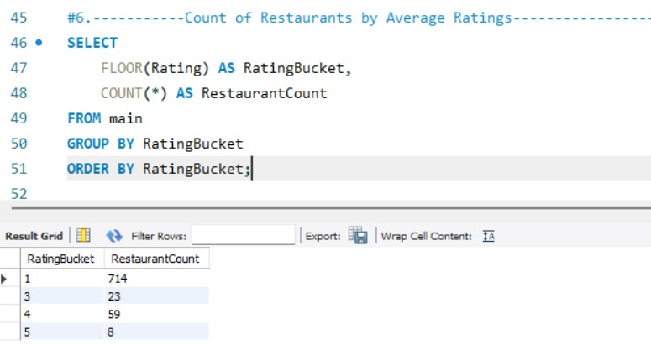
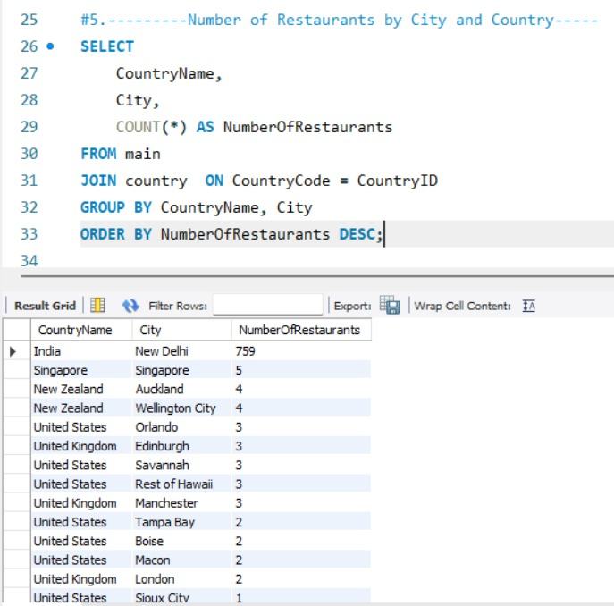
QUERIES

Slide 15
Key Learnings
Restaurant Distribution:
New Delhi dominates with a significant number of restaurants, but top-rated restaurants are found in smaller cities like Beechworth (4.6), Inner City (4.9), and Quezon City (4.8).
North Indian cuisine is prevalent in New Delhi, indicating a strong regional preference.
Ratings Insights:
Average rating across restaurants is 2.89, with a majority (381) rated at 2.9, showing a skewed distribution toward lower ratings.
High-rated restaurants (4.5–4.9) are rare, comprising only ~3% of the dataset, suggesting quality differentiation is a competitive advantage.
Cost Analysis:
Average cost for two in USD shows most restaurants fall in the low-cost category (<$50, 9362 restaurants), with only 9 in the premium category (≥$250).
Higher costs don’t necessarily correlate with higher ratings, indicating value-driven customer preferences.
Operational Features:
Only 12.12% of restaurants offer table booking, and 8.63% provide online delivery, highlighting limited adoption of these services.
Restaurants with online delivery tend to have slightly higher ratings, suggesting customer convenience impacts perception.

Slide 16
Challenges
Data Cleaning :
Many missing values .
Inconsistent formats for dates and addresses .
Skewed Rating Distribution :
Ratings cluster heavily at 2.9; hard to identify quality differentiators .
Price vs Rating Mismatch:
No clear correlation between high price and high ratings .
Premium restaurants do not always score higher .
Balancing Tools :
Choosing what to show in each tool (Excel vs PowerBi vs Tableau vs Mysql)
to avoid duplication and ensure unique value .

Slide 17
Recommendations
Fix Data Issues:
Add missing location details (e.g., Curry Man’s zero coordinates).
Standardize address/date formats.
Collect data up to 2025 for recent trends.
Promote Delivery & Booking:
Support more restaurants (8.63% have delivery) with delivery setup, as it improves ratings.
Push table booking (12.12% adoption) for premium restaurants ($250+ cost).
Learn from Top Restaurants:
Study high-rated spots (e.g., Inner City, 4.9) for best practices.
Market affordable, high-rated restaurants (<$50, 9362 total).
Time Openings Right:
Boost July–September openings (2460 in Q3) with promotions.
Analyze Q3 popularity (e.g., festivals) for better planning.
Grow in New Areas:
Expand to high-rated cities like Beechworth (4.6), Makati City (4.65).
Add diverse cuisines beyond North Indian.

Slide 18
Customer Prefer low–cost options – value-driven behavior .
Top-rated restaurants are rare- quality can be a key differentiator.
Delivery and booking services are underused but linked to better
ratings.
Cities like Inner city & Beechworth show high potential for growth .
Better data collection is essential for future strategic planning .
Conclusion

Slide 19
